Slide 1

Analysis of Breast Cancer
Group Members:
Afshan Waseem(232561)
Owais Farooq(232566)
Eman Rohail(232576)

Slide 2
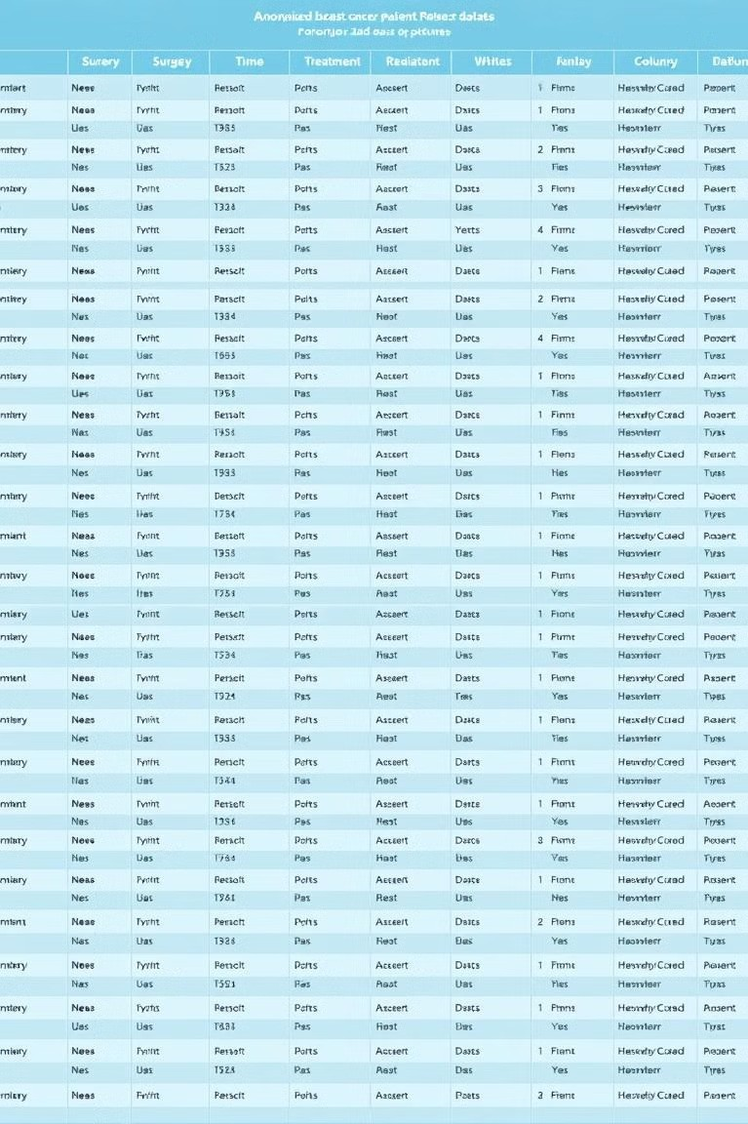
Data Collection and Cleaning
Data Collection
We collected our data by conducting a survey of cancer patients at NORI Hospital.
Data Cleaning
Data cleaning involved handling missing values, and correcting inconsistencies for accurate analysis.

Slide 3

Objective
Recovery Rate
The analysis focuses on identifying dose influencing recovery rates and understanding the effectiveness of various treatment approaches.
Identifying Correlations
The analysis investigates potential correlations between factors like age, stage, and treatment regimen.
Assessing Side Effects
The analysis aims to understand the prevalence and severity of side effects associated with different treatment modalities, particularly chemotherapy.

Slide 4
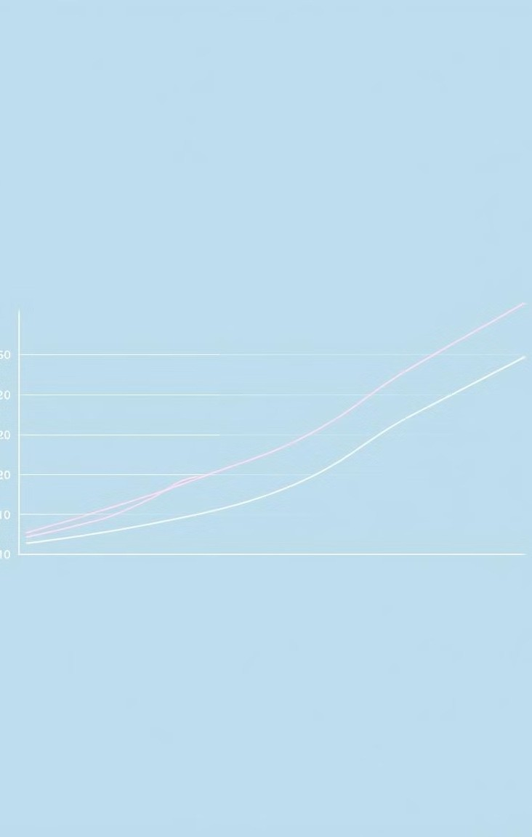
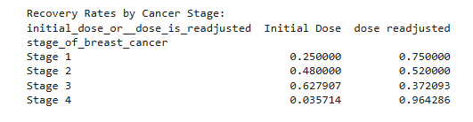
Recovery Rate
Formula:
To find the recovery rate with respect to intial dose or the dose is readjusted according to patient need use formula:
recovery_rate = recovery_rate.value_counts(normalize=True) * 100

Slide 5
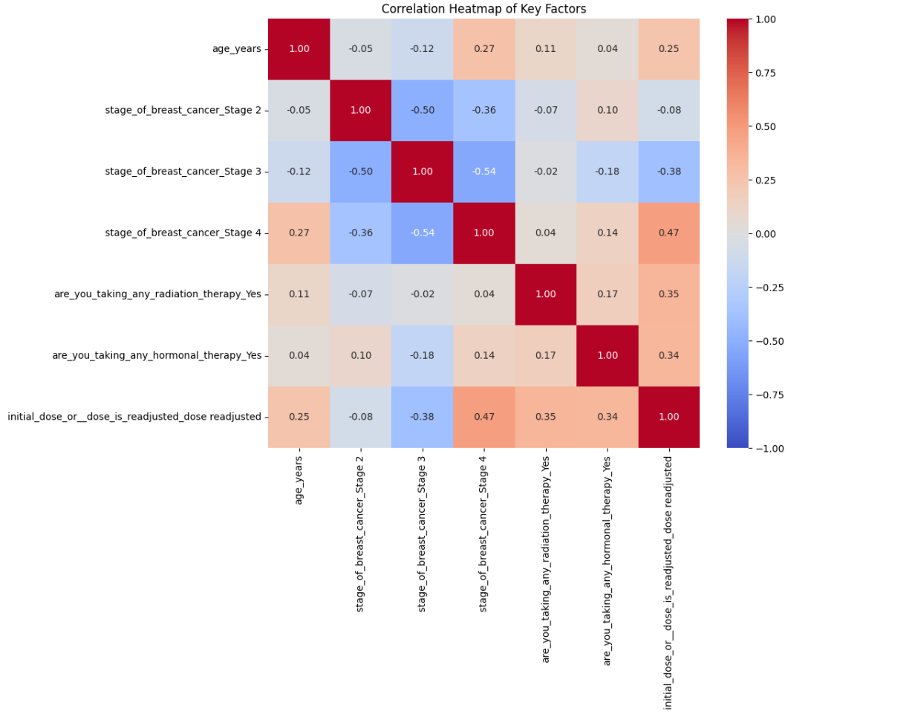
Correlation Heatmap
.

Slide 6
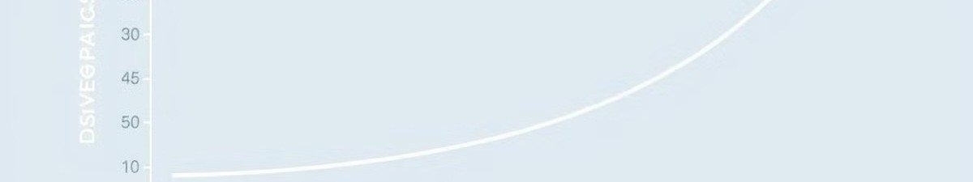
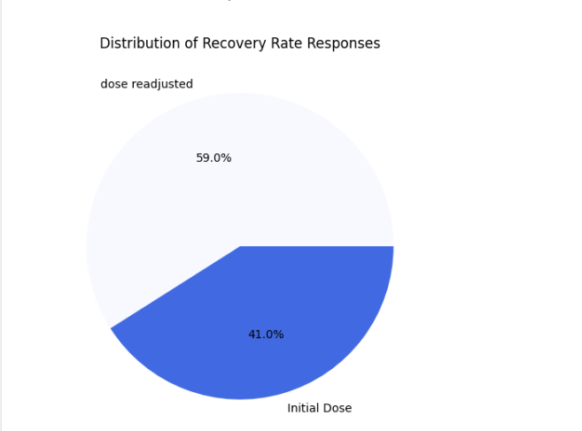
Recovery with respect to dose

Slide 7
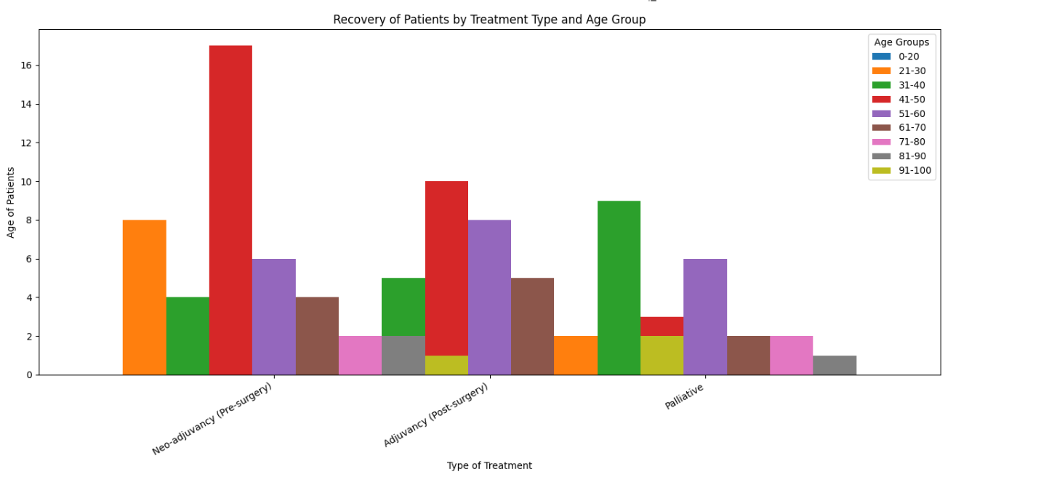
Recovery with respect to treatment

Slide 8
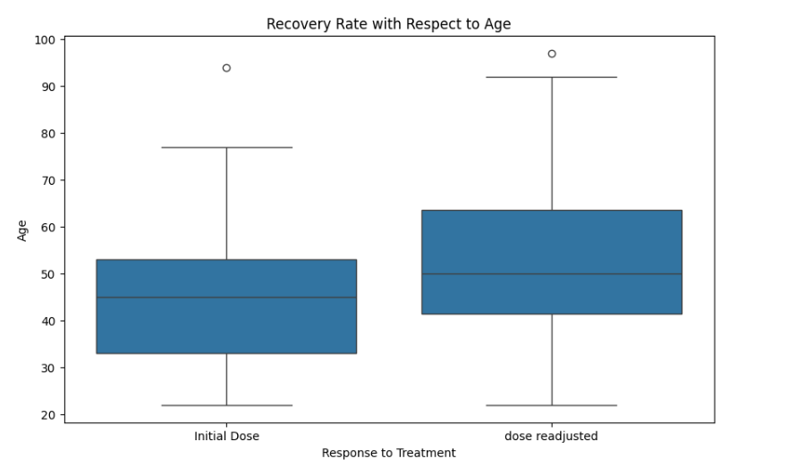
Recovery with respect to age

Slide 9
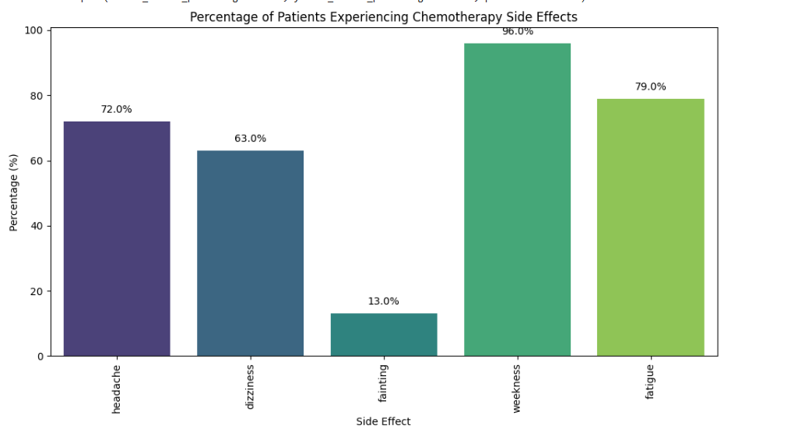
Side Effect After Chemotherapy

Slide 10
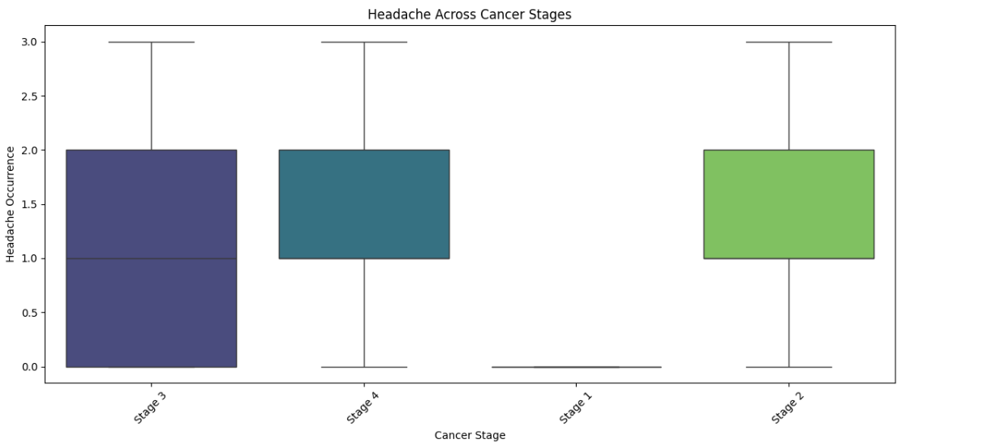
Side Effect After Chemotherapy in different stages

Slide 11
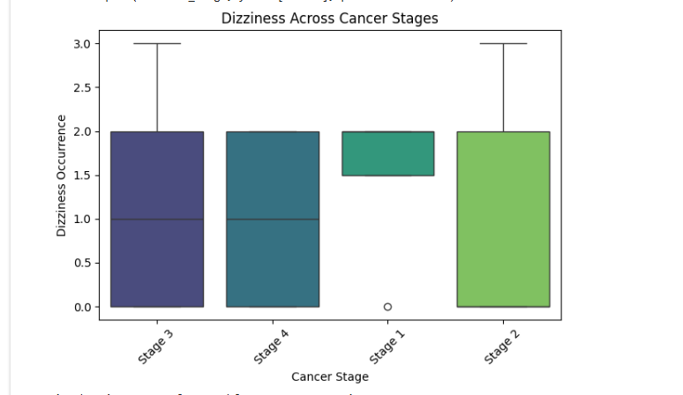
Side Effect After Chemotherapy in different stages

Slide 12
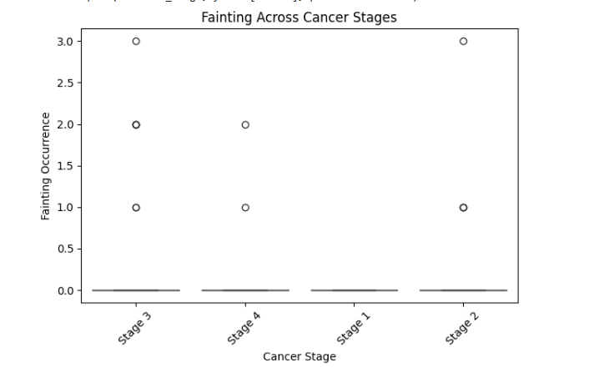
Side Effect After Chemotherapy in different stages

Slide 13
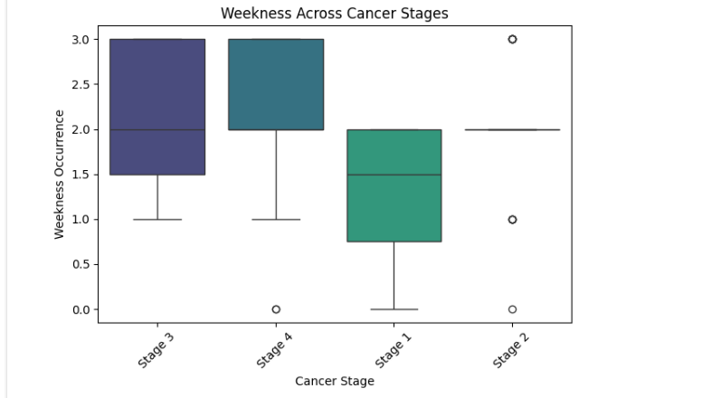
Side Effect After Chemotherapy in different stages

Slide 14
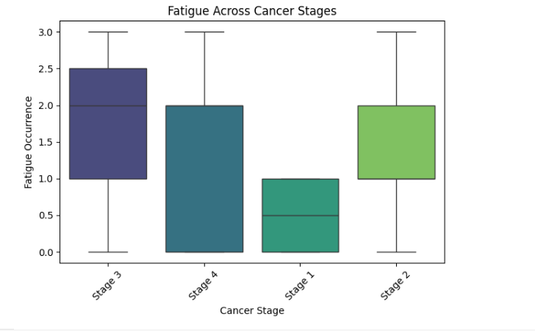
Side Effect After Chemotherapy in different stages

Slide 15

Conclusion
Recovery rates vary significantly across age groups, cancer stages, and treatment types, emphasizing the importance of early detection and personalized care.
Strong correlations were observed between treatment responses and factors like age, radiation, and hormonal therapies.
Tailored approaches to manage side effects can enhance patient outcomes and improve treatment tolerability.

